Slide 1
Today’s class
Homework 2
Homework 1
Command Pattern Demo
Refactoring
SOLID Principles: Open-Close Principle, Liskov Substitution Principle, Interface Segregation Principle
UML Sequence Diagrams
Inner Classes
Factory
Testing a class in isolation
MVC Lite
Homework 3

Slide 2
Homework 2

Slide 3
Homework 1

Slide 4
Command pattern demo

Slide 5
Refactoring
Refactoring is changing the structure of the code without changing its functionality
(function example)

Slide 6
When to refactor
Code smell: some code that indicates there may be a larger design issue
Example, Homework 1 violation of SRP
Refactor when you end up with a high volume of technical debt (check out SonarQube)
Technical debt is what you end up with when you implement the easy solution and not the correct solution

Slide 7
How to refactor
1. Write unit tests to extensively cover the code that will be refactored
2. Plan your design changes
3. Refactor
4. Run unit tests to make sure the code works the same as it did before

Slide 8
Refactor demo
Homework 1

Slide 9
Why refactor?
Erase potential areas for bugs
Improve design (increase potential for extensibility and maintainability)
Remove dependencies (decrease complexity)

Slide 10
Open-Close principle
Software Entities (classes, modules, functions, etc.) should be open for extension, but closed for modification.
Rather than change behavior of code, you should extend it when functionality changes rather than changing the behavior of the old code that already works. Bug fixes should still occur.
The Open-Close Principle relies on “class-stacking” (subclassing)

Slide 11
Open-Close principle
How to use it: abstraction!
Have code depend on abstractions, not concrete classes
The way to extend behavior is to create a class based on that abstraction

Slide 12
Open-close principle
(Client/Server example)

Slide 13
Open-close principle
When you are checking actual types of objects at runtime, you are likely violating the open-close principle (code smell)
The problem with seeing this in one place is that it likely means it’s used in multiple places

Slide 14
Open-close principle
(example)
Notes:
public interface Shape {
}
class Circle implements Shape {
Circle(int radius) { /* ... */ }
}
class Rectangle implements Shape {
Rectangle(int height, int width) { /* ... */ }
}
public class Main {
public static void main (String[] args) {
Shape[] shapes = new Shape[2];
shapes[0] = new Circle(1);
shapes[1] = new Rectangle(1, 2);
WriteShapes(shapes);
}
public static void WriteShapes(Shape[] shapes){
for(Shape shape:shapes){
if(shape instanceof Circle)
System.out.println("Circle");
else if(shape instanceof Rectangle)
System.out.println("Rectangle");
}
}
}

Slide 15
Open-close principle: heuristics
Make all member variables private
Hide the state of any class
If any (external) code depends on a field, the OCP is broken because any changes to that field affect the code that calls it (C# properties vs fields)
Private fields (as opposed to protected fields) force child classes to add behavior rather than modify it

Slide 16
Open-close principle heuristics
No Global Variables – Ever
Same reason as why you make private member variables
However, with C#, this is appropriate to violate on occasion (DateTime.Now)

Slide 17
Open-close principle: heuristics
RTTI (run-time type identification) is dangerous
RTTI = casting
Methods shouldn’t depend on specific (concrete) types

Slide 18
Open-close principle – why?
Every time you open a file to make modifications, you increase the likelihood of breaking something
Once a unit has been created and thoroughly tested to ensure it works, for the most part, it can be left alone and can just sit there. You know it will work because it’s been working and it’s been tested thoroughly, and no one has had any reason to open it or change it

Slide 19
Liskov substitution principle
Functions that use pointers or references to base classes must be able to use objects of derived classes without knowing it.
In Java, everything is a reference (non-primitive types)

Slide 20
Liskov substitution principle
Rule of thumb: If creating a subtype requires changes in the base class, it should not be a subtype of that base class
No longer should you use “Practical Inheritance”, but now “Behavioral Inheritance”
Just because a Square is a Rectangle doesn’t mean Square should inherit from Rectangle. Adding a Square class would require separate methods that consume Rectangles/Squares (violating this principle).
(example Square and Rectangle – SetHeight/SetWidth)

Slide 21
Liskov substitution principle
When designing classes and considering inheritance, you should think about whether the inheritance might break reasonable assumptions about the base class.
Design by contract.

Slide 22
Liskov substitution principle
(example)
Notes:
class Rectangle {
private double height;
private double width;
public setHeight(double newHeight) { height = newHeight; }
public setWidth(double newWidth) { width = newWidth; }
public double getHeight() { return height; }
public double getWidth() { return width; }
}
public class Main {
public static void main (String[] args) {
Rectangle r = new Rectangle();
setInitialHeightAndWidth(r);
}
public static void setInitialHeightAndWidth(Rectangle r){
r.setHeight(5);
r.setWidth(10);
}
}

Slide 23
Liskov substitution princple
A square might be a rectangle, but a square object is different than a rectangle object – their public behavior is inconsistent
Is-a relationships should pertain to behavior

Slide 24
Why use LSP?
Prevents bugs – there are assumptions consuming classes make about objects that are passed in. Using the LSP, you help reduce bugs created as a result of assumptions.

Slide 25
Interface segregation principle
Clients should not be forced to depend upon interfaces that they do not use
Separate clients mean separate interfaces
Do not add dependencies to a single class – consumers will now have dependencies to all the classes instead of the single one

Slide 26
Interface segregation principle
(example)
Notes:
abstract class Door{
public void lock() {}
public void unlock() {}
public boolean isDoorOpen() { return false; }
}
class Timer{
public void register(int timeout, TimerClient client);
}
interface class TimerClient{
void Timeout();
}
class TimedDoor {
//TODO
}

Slide 27
Interface segregation principle
Problem with class stacking in this example:
Subclasses of door – whether they’re timed or not – will need to provide a default implementation of TimerClient.Timeout()
Or the door can implement this. However, this creates interface pollution (implementing this interface for the sake of one subclass) and leads to fat interfaces (when other functionality is added to TimerClient, the Door interface will need to be updated further to provide implementations for it)

Slide 28
Interface segregation principle
If we change the interface for TimerClient, we will also need to update the Door – why should Door (and its subtypes) be dependent on functionality that it doesn’t even care about? This significantly increases time for changes related to the TimerClient and increases the possibility of something else breaking somewhere

Slide 29
Interface segregation principle – why use it?
Prevent code-bloat.
Prevent violation of LSP (via implementing default implementations that do nothing in the base class).

Slide 30
Interface segregation principle – why use it?
Prevent Rigidity/Fragility in the code – based on the example, you would need to update the Door class and all its subclasses if a change to the interface were made. Changes to the abstract interface (or even to something that consumes door) can cause bugs in completely unrelated modules

Slide 31
Interface segregation principle – why use it?
In addition, you are preventing recompiles. If recompiles are lengthy, engineers might start putting code in the wrong places to reduce compile time.
Prevent coupling – fat interfaces create inadvertent couplings between clients that ought otherwise to be isolated.

Slide 32
Uml sequence diagrams
Depict a sequence of messages being passed around for some method as well as depict the activity of objects

Slide 33
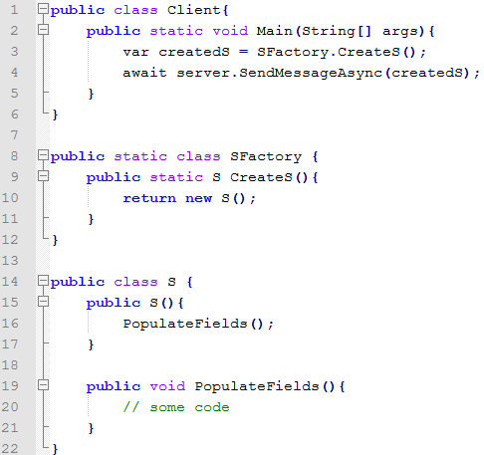
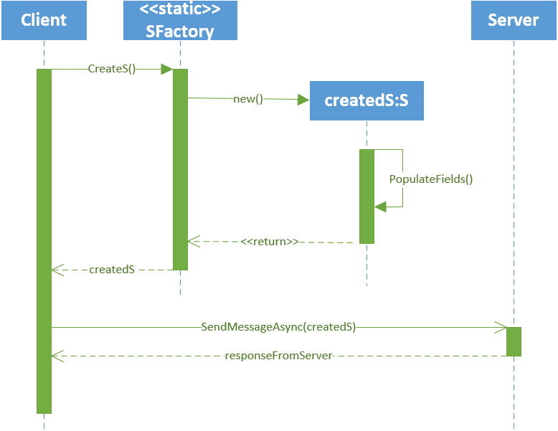
Uml sequence diagrams

Slide 34
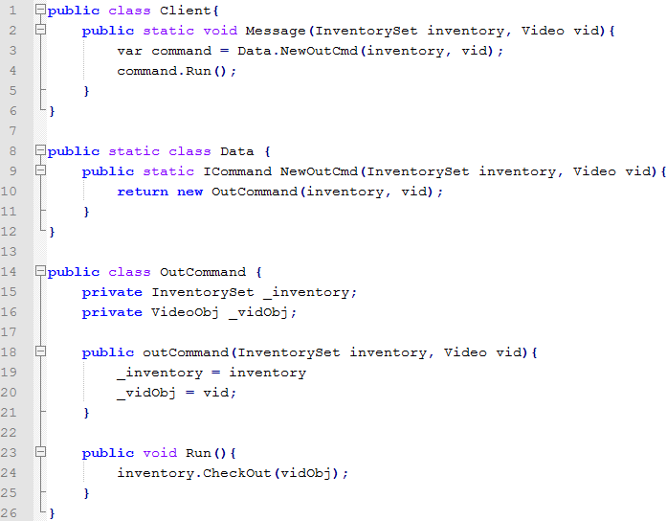
Uml sequence diagram
Convert the following code to a UML Sequence Diagram:

Slide 35
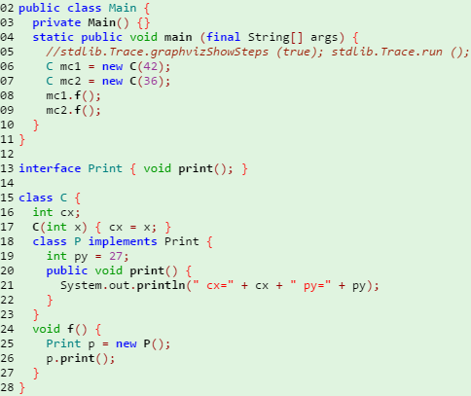
Inner classes
Classes that are defined within another class (e.g. RecordObj and InventorySet from Homework 2)
Inner classes can’t be instantiated outside of their containing classes
(demo)
Notes:
public class Main {
private Main() {}
static public void main (final String[] args) {
//stdlib.Trace.graphvizShowSteps (true); stdlib.Trace.run ();
C mc1 = new C(42);
C mc2 = new C(36);
mc1.f();
mc2.f();
}
}
interface Print { void print(); }
class C {
int cx;
C(int x) { cx = x; }
class P implements Print {
int py = 27;
public void print() {
System.out.println(" cx=" + cx + " py=" + py);
}
}
void f() {
Print p = new P();
p.print();
}
}

Slide 36
Inner classes
Can inner classes be instantiated by other classes?

Slide 37
Inner classes
Can static methods of inner classes be called from other classes?

Slide 38
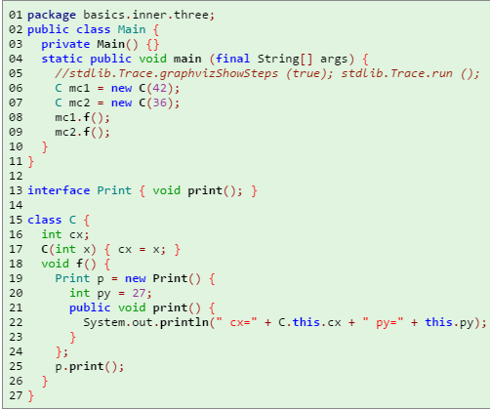
Inner classes
Inner classes can be declared in the middle of a method – why might you want to do that?
Notes:
public class Main {
private Main() {}
static public void main (final String[] args) {
//stdlib.Trace.graphvizShowSteps (true); stdlib.Trace.run ();
C mc1 = new C(42);
C mc2 = new C(36);
mc1.f();
mc2.f();
}
}
interface Print { void print(); }
class C {
int cx;
C(int x) { cx = x; }
void f() {
Print p = new Print() {
int py = 27;
int cx = 5656;
public void print() {
System.out.println(" P.cx=" + this.cx);
System.out.println(" cx=" + C.this.cx + " py=" + this.py);
}
};
p.print();
}
}

Slide 39
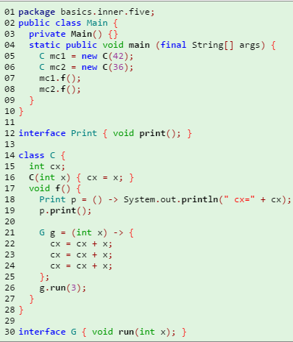
Inner classes
Unnamed inner classes that just have a single function can use a shorthand
Notes:
public class Main {
private Main() {}
static public void main (final String[] args) {
C mc1 = new C(42);
C mc2 = new C(36);
mc1.f();
mc2.f();
}
}
interface Print { void print(); }
class C {
int cx;
C(int x) { cx = x; }
void f() {
Print p = () -> System.out.println(" cx=" + cx);
p.print();
G g = (int x) -> {
cx = cx + x;
cx = cx + x;
cx = cx + x;
};
g.run(3);
}
}
interface G { void run(int x); }

Slide 40
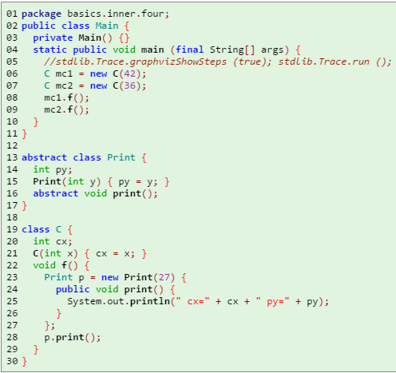
Inner classes
Inner classes can inherit from classes rather than interfaces
Notes:
public class Main {
private Main() {}
static public void main (final String[] args) {
//stdlib.Trace.graphvizShowSteps (true); stdlib.Trace.run ();
C mc1 = new C(42);
C mc2 = new C(36);
mc1.f();
mc2.f();
}
}
abstract class Print {
int py;
Print(int y) { py = y; }
abstract void print();
}
class C {
int cx;
C(int x) { cx = x; }
void f() {
Print p = new Print(27) {
public void print() {
System.out.println(" cx=" + cx + " py=" + py);
}
};
p.print();
}
}

Slide 41
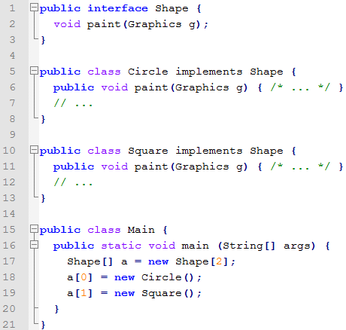
Factories
Typical code for creating new objects

Slide 42
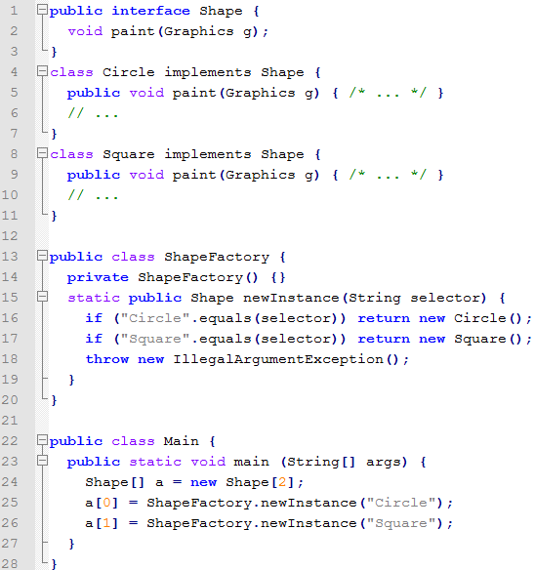
Static factory method
A factory allows concrete class names to be hidden

Slide 43
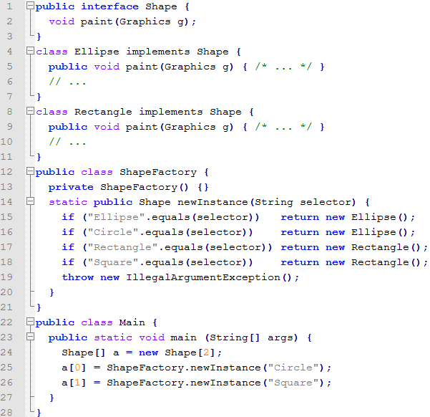
Static factory method
Benefit: Changing class names does not force Client code to change (nor should it)

Slide 44
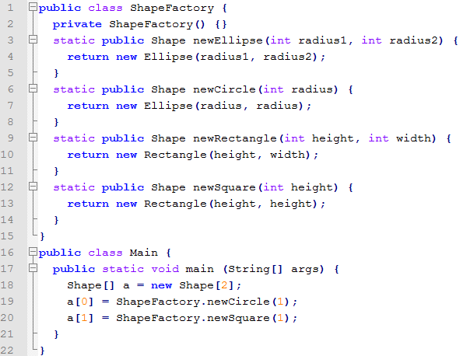
Static factory class
An alternative to what we’ve seen, you can replace the giant if/else statement with individual class names

Slide 45
Homework 3
Class Diagram of Homework 2
Adding Undoable commands

Slide 46
Testing a class in isolation
myhw3/command/CommandHistoryTEST.java

Slide 47
Mvc

